Slide 1
Interpreting American Sign Language Using Machine Learning
Project Team:
Akriti Bhanot
Nicholas Chin
Krishna Priya Jyesta
Sirisha Kasibhotla
Adeyemi Omisakin

Slide 2
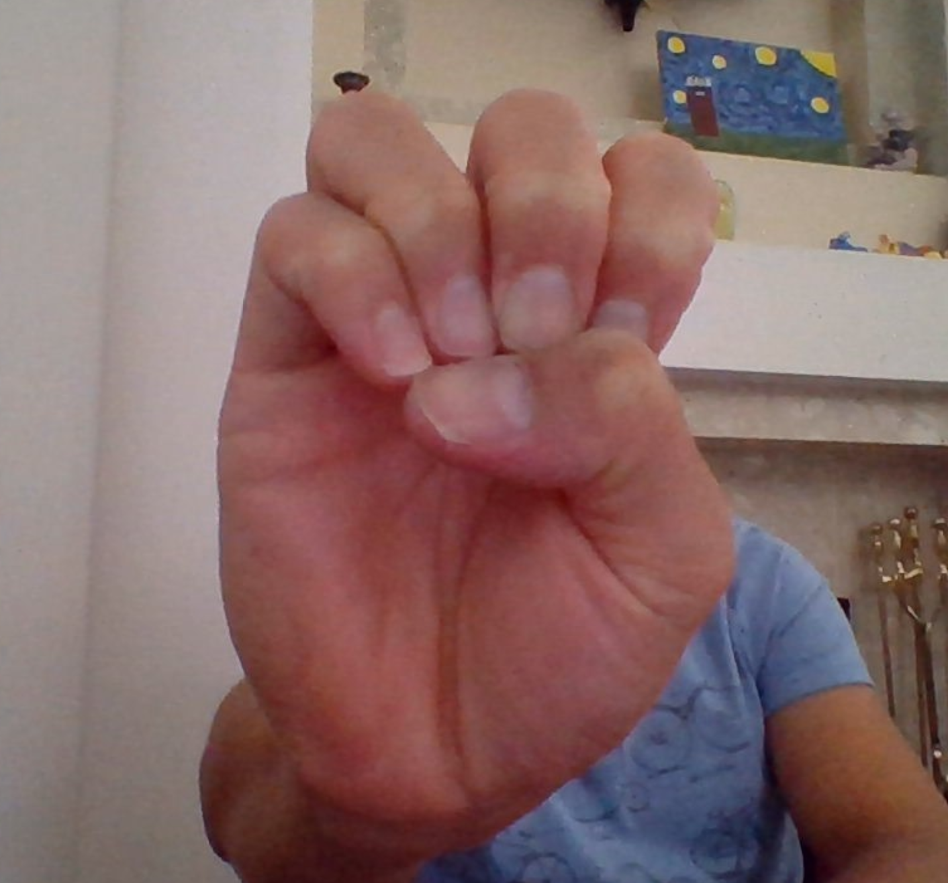
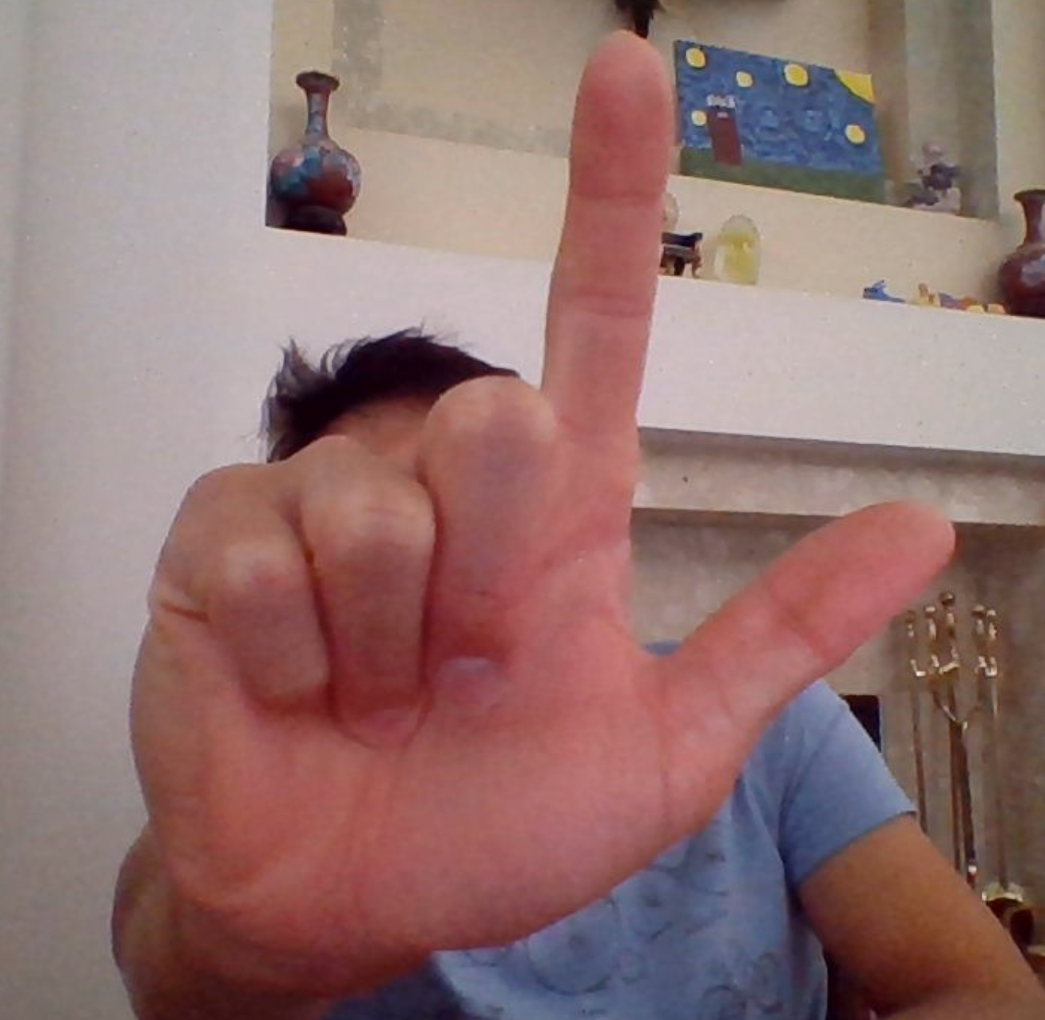
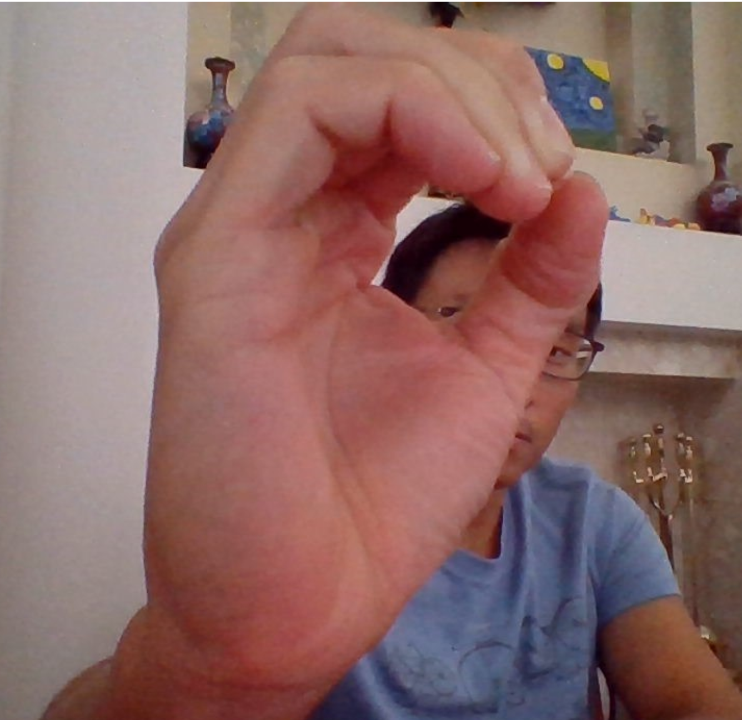
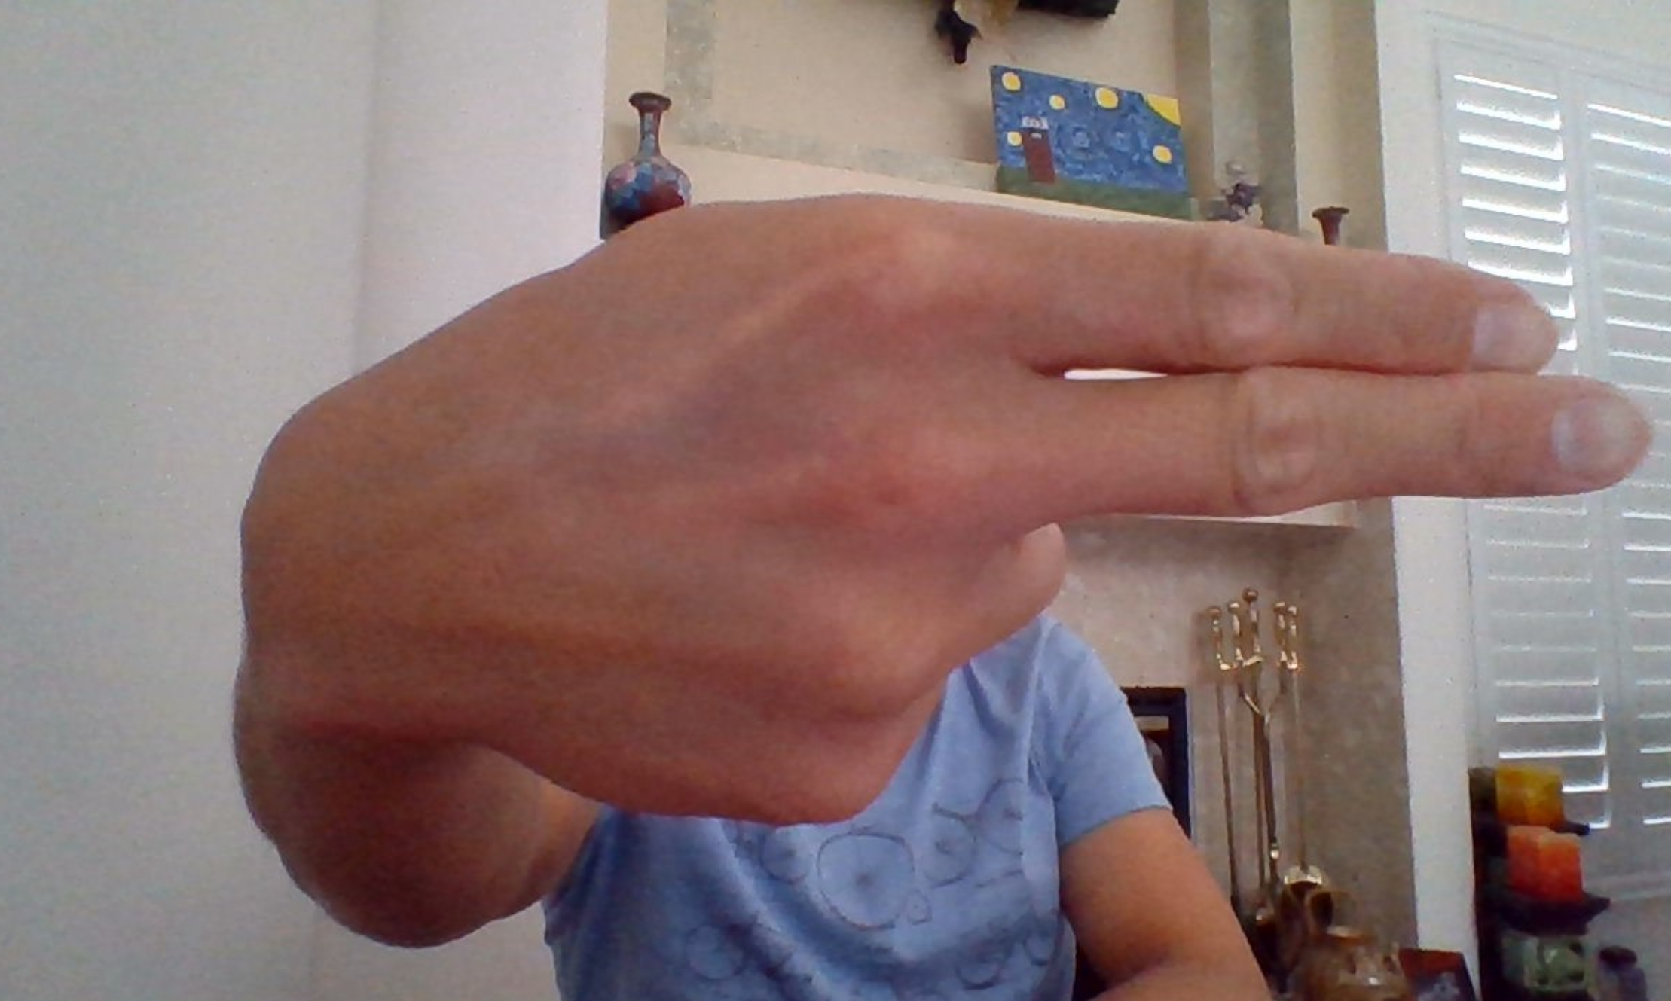

Slide 3
American Sign Language (ASL)
Used by the deaf and hard-of-hearing communities, as well as those with communication disorders
There are 300 distinct sign languages around the world!
Around 1 million people in the United States use ASL to communicate
98% of deaf people do not receive education in sign language
72% of families do not sign with their deaf children
70% of deaf people don't work or are underemployed
1 in 4 deaf people has left a job due to discrimination

Slide 4
Project Motivation & Scope
Our goal was to build a mobile application that uses a camera to capture a person signing the ASL, and translate it in real time.
There are many other apps which requires purchase with similar functionalities & our goal is to make our app available for everyone free of cost with more functionalities included.
Used our own pictures and supplemented them with ones found online (from Kaggle)
Build a labeled library to train our model on
Test different image classification techniques

Slide 5
Data Set Creation
Created our own dataset by adding the images of the ASL Alphabets in the Shared Google Drive folder .
The total data set contains 5408 images where each alphabet folder contains close to 200 images.
After the train test split of 80:20 the training dataset contains a total of 4326 images.
And the test dataset contains 1082 images.

Slide 6

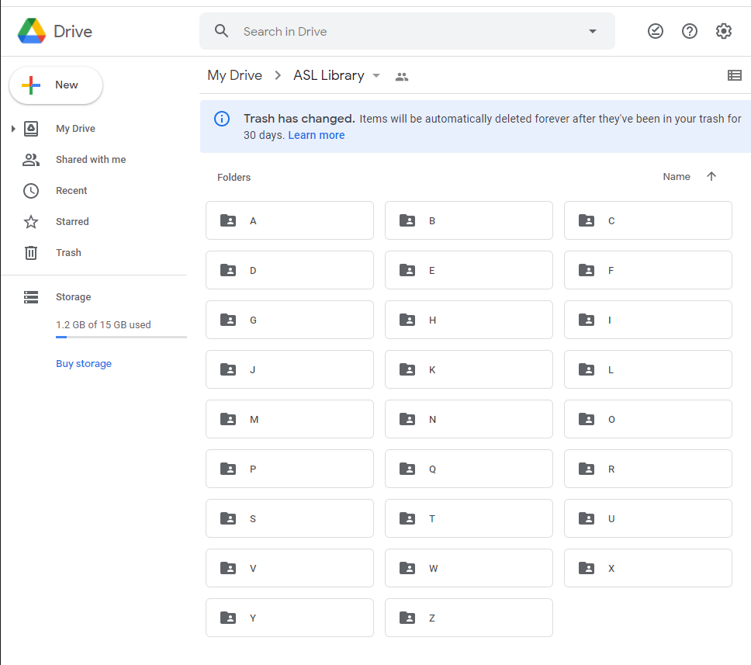
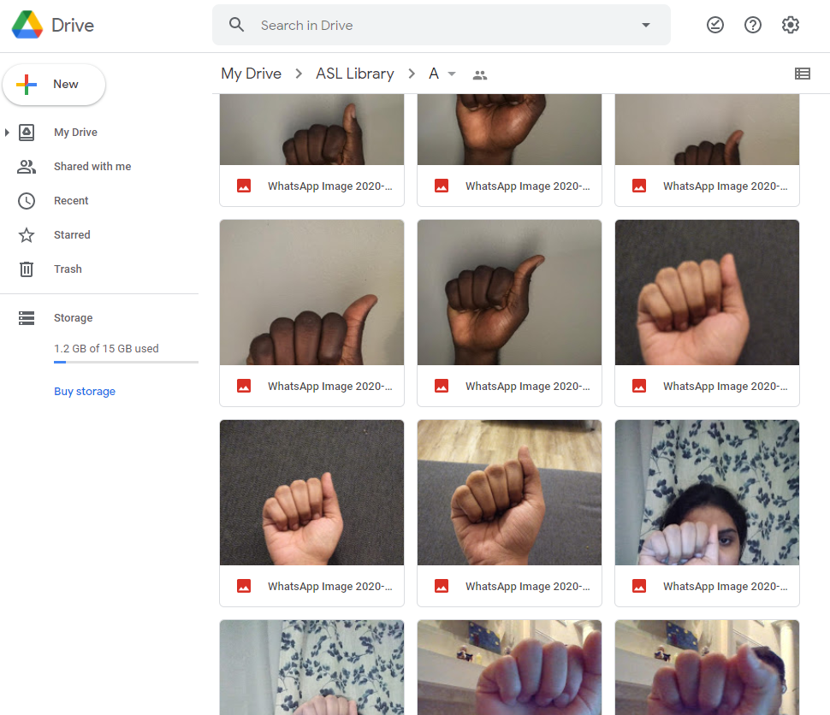

Slide 7
Data Preprocessing
The training dataset has 4326 total images with the images being resized to 80 by 80 pixels and converted to grayscale for storage and processing purpose.
The input layer of our model will take images of size (80,80,1) where 80,80 are height and width of the image while 1 represents the colour channel of the image for grayscale.
The output layer of our model will have 26 neurons for 26 different letters, and the activation function will be softmax since it is a multiclass classification problem.

Slide 8
Data Preprocessing
After the dataset creation each of the images was converted to a numpy array along with its label.
One of the challenges that we faced while training our model was that we needed more data for the individual alphabets as many alphabets were looking similar to each other, since there are 26 distinct alphabet characters so more data is needed to train the model .
To solve that issue, we supplemented our dataset with more of our own ASL alphabet images, images from Kaggle and google images.

Slide 9
Project structure
Building the Alphabet Image Dataset
Training the machine learning model
Testing on the Test Data set
Accuracy achieved

Slide 10
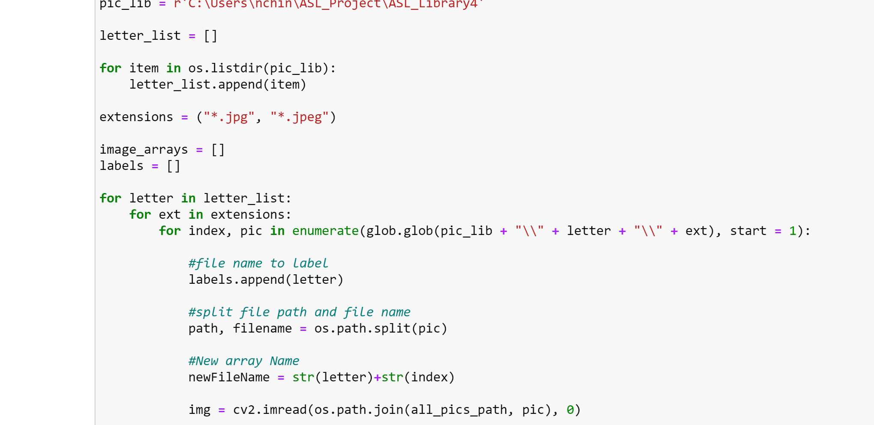

Slide 11
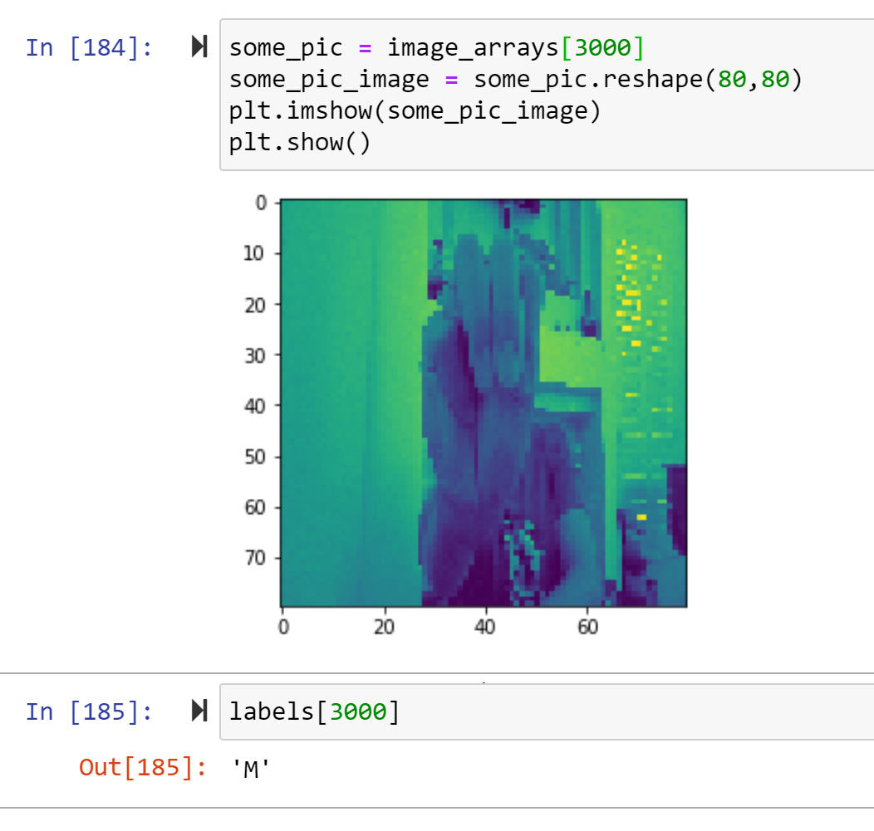

Slide 12
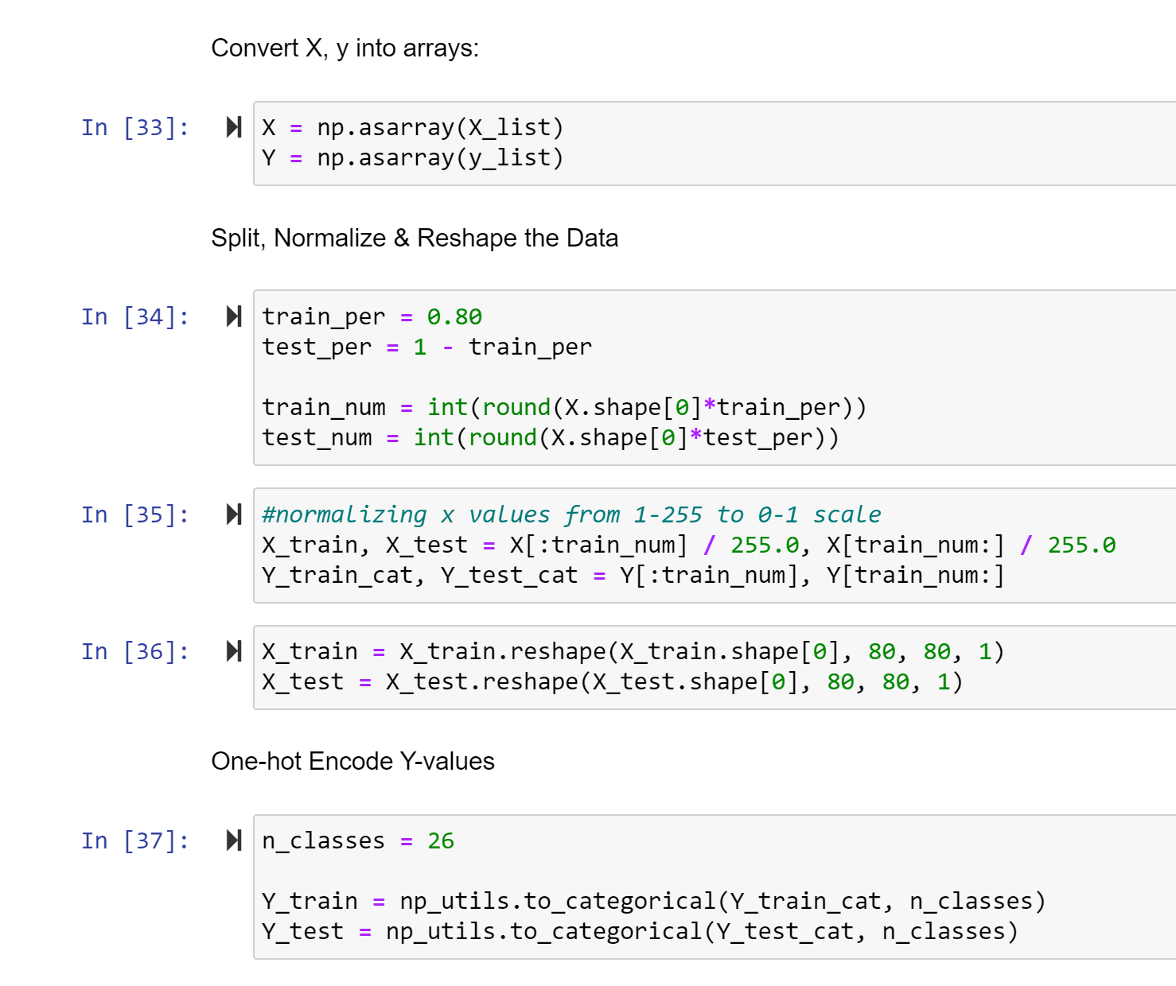

Slide 13
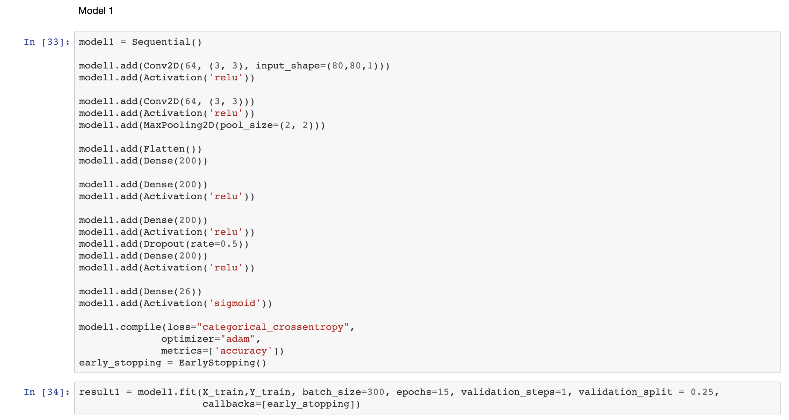

Slide 14
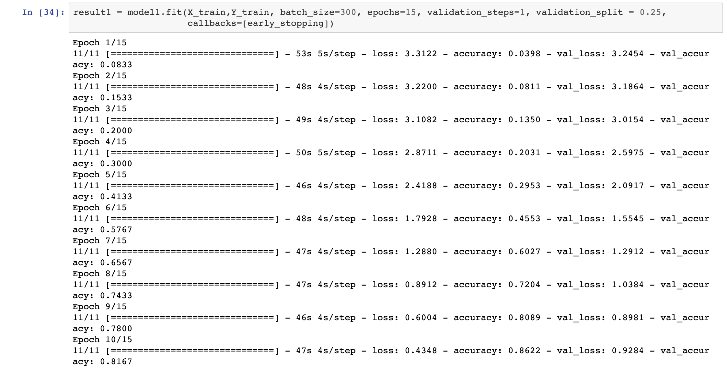

Slide 15
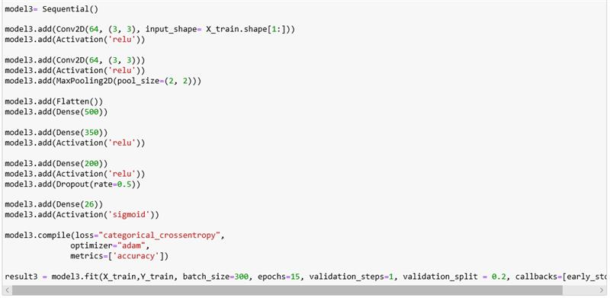

Slide 16
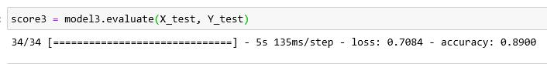
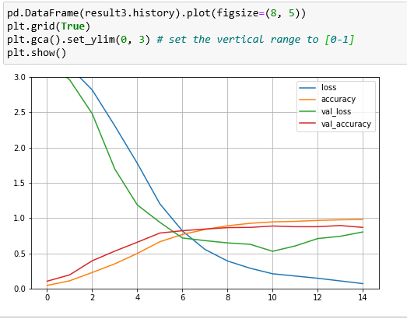

Slide 17
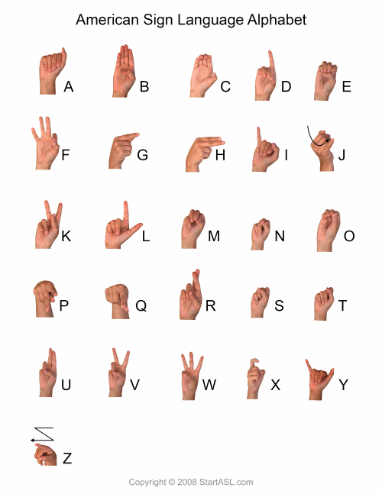

Slide 18
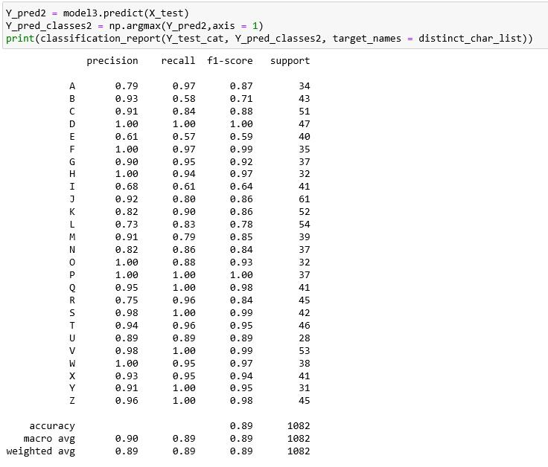

Slide 19
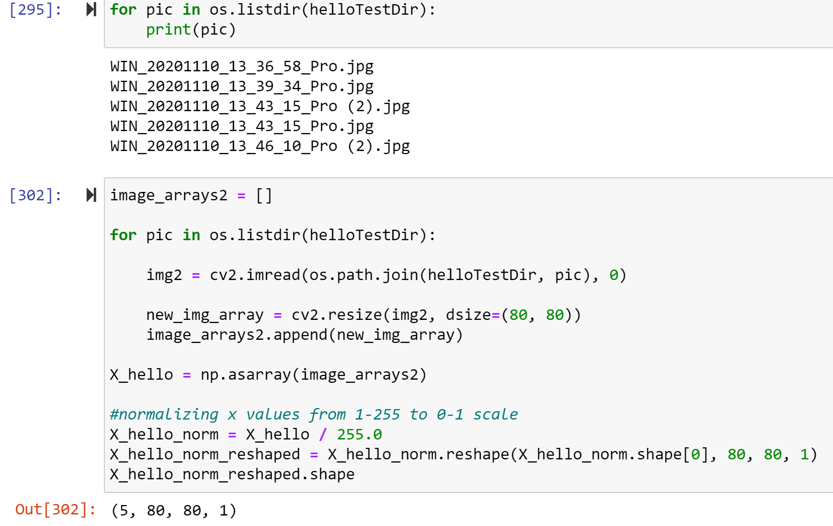

Slide 20
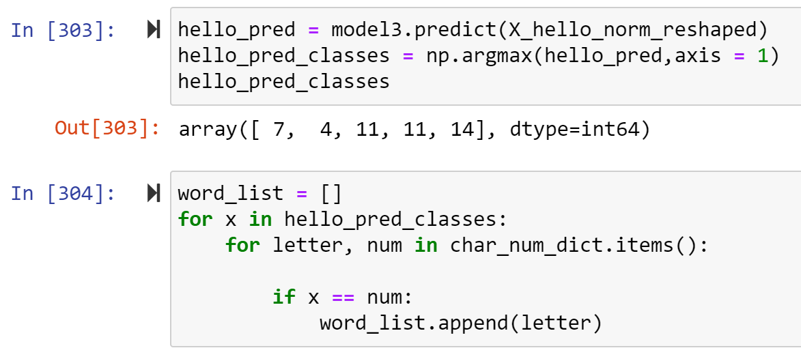

Slide 21
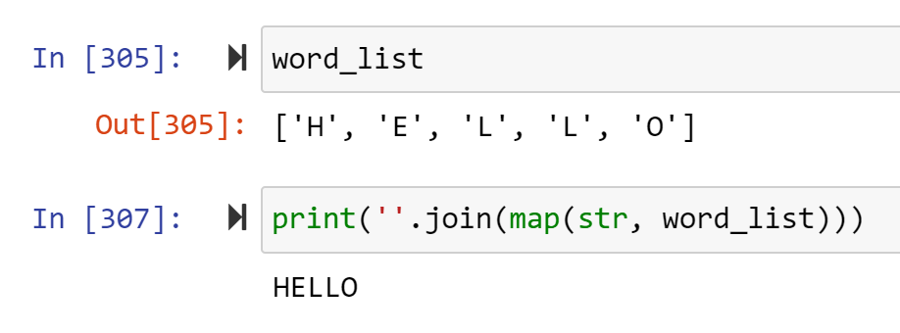

Slide 22
Findings…
CNNs were superior immediately!
Played with a lot of different parameters:
Complexity
Learning rate
Optimizers
Number of filters
Number of hidden layers
Batch sizes and epochs
Incrementally improved model but was no where near the theoretical maximum of 100%
Needed more data!

Slide 23
The Next Step
Since the majority of the communications semantic content lies in movement, facial expression and stress placed signs, we are looking to add this to the system
We are also looking at the possibility of generating complete sentences from language and context models. This might be done using HMMs
Have different languages available
Increase the complexity of the model as we accumulate more data
Recognize sign from video and have fast written translations
The envisioned final product is a mobile app that non-sign language speakers could use to translate and vice-versa

